Slide 1
Web Development Bootcamp Class – 2: HTML
Trainer: Sobia Noor

Slide 2

HTML Syntax
<!DOCTYPE html> <html> <head> <title>Page Title</title> </head> <body> <h1>My First Heading</h1> <p>My first paragraph.</p> </body> </html>

Slide 3

DOCTYPE
The DOCTYPE declaration defines the document type to be HTML

Slide 4


Syntax Explaination
The text between <html> and </html> describes an HTML document
The text between <head> and </head> provides information about the document
The text between <title> and </title> provides a title for the document

Slide 5
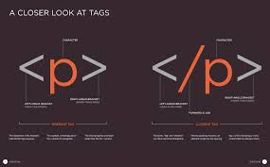
Continued…
The text between <body> and </body> describes the visible page content
The text between <h1> and </h1> describes a heading.
The text between <p> and </p> describes a paragraph

Slide 6
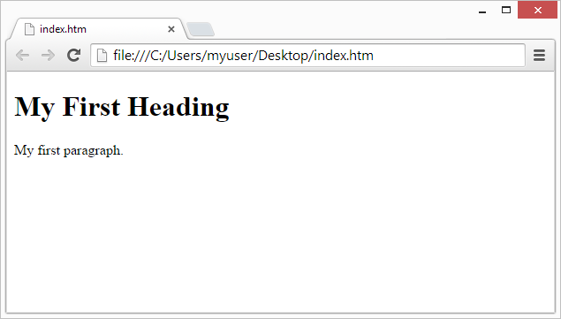
Tags
<tagname>content</tagname>
HTML tags normally come in pairs like <p> and </p>
The first tag in a pair is the start tag, the second tag is the end tag
The end tag is written like the start tag, but with a / slash before the tag name

Slide 7

Write HTML Using Notepad Notepad++ or TextEdit
Step 1: Open Notepad
Step 2: Write Some HTML
Step 3: Save the HTML Page

Slide 8
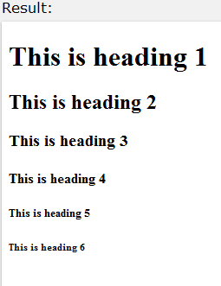
HTML Headings
HTML headings are defined with the <h1> to <h6> tags:
<h1>This is heading 1</h1>
<h2>This is heading 2</h2>
<h3>This is heading 3</h3>
<h4>This is heading 4</h4>
<h5>This is heading 5</h5>
<h6>This is heading 6</h6>

Slide 9
HTML Paragraphs
HTML paragraphs are defined with the <p> tag:
Example:
<p>This is a paragraph.</p> <p>This is another paragraph.</p>
Output:
This is a paragraph.
This is a paragraph.

Slide 10
HTML Links
HTML links are defined with the <a> tag:
Example
<a href="http://www.w3schools.com">This is a link</a>
Output
This is a link

Slide 11

HTML Images
HTML images are defined with the <img> tag.
The source file (src), alternative text (alt), and size (width and height) are provided as attributes:
Example
<img src="w3schools.jpg" alt="W3Schools.com" width="104" height="142">
Output:

Slide 12
The lang Attribute
he document language can be declared in the <html> tag.
The language is declared in the lang attribute.
<html lang="en-US">

Slide 13
The title Attribute
HTML paragraphs are defined with the <p> tag.
In this example, the <p> element has a title attribute. The value of the attribute is "About W3Schools":
Example:
<p title="About W3Schools">
Output:
About W3Schools

Slide 14
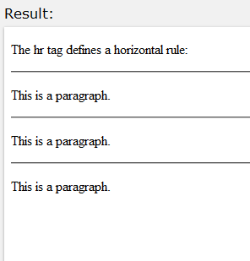
HTML Horizontal Rules
The <hr> tag creates a horizontal line in an HTML page.
The hr element can be used to separate content:
Example:
<p>This is a paragraph.</p> <hr> <p>This is a paragraph.</p> <hr> <p>This is a paragraph.</p>

Slide 15
The HTML <meta> Element
The HTML <meta> element is also meta data.
It can be used to define the character set, and other information about the HTML document.
In the chapter about HTML styles you discover more meta elements:
The HTML <style> element is used to define internal CSS style sheets.
The HTML <link> element is used to define external CSS style sheets.

Slide 16
HTML Line Breaks
The HTML <br> element defines a line break.
Use <br> if you want a line break (a new line) without starting a new paragraph:
Example:
<p>This is<br>a para<br>graph with line breaks</p>
Output:
This is a para graph with line breaks

Slide 17
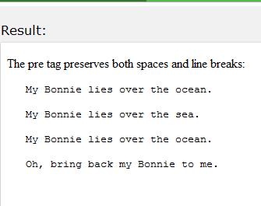
The HTML <pre> Element
The HTML <pre> element defines preformatted text.
Example
<pre> My Bonnie lies over the ocean. My Bonnie lies over the sea. My Bonnie lies over the ocean. Oh, bring back my Bonnie to me. </pre>

Slide 18
HTML Styling
Every HTML element has a default style (background color is white and text color is black).
Changing the default style of an HTML element, can be done with the style attribute.

Slide 19
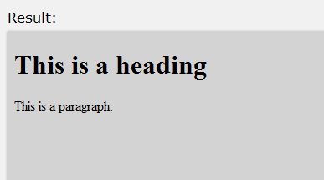
Example
<body style="background-color:lightgrey"> <h1>This is a heading</h1> <p>This is a paragraph.</p> </body>

Slide 20
Text
Text Color
<h1 style="color:blue">This is a heading</h1>
Fonts
<h1 style="font-family:verdana">This is a heading</h1>
Text Size
<h1 style="font-size:300%">This is a heading</h1>
Text Alignment
<h1 style="text-align:center">Centered Heading</h1>

Slide 21
Text Formatting Elements
Bold <b>
Strong <strong>
Italic and Emphasized <i> <em>
Small <small>
Marked <mark>
Deleted <del>
Inserted <ins>
_{Subscript} <sub>
^{Superscript} <sup>
---------------------------------------
This text is bold This text is italic This is ^{superscript}

Slide 22
Quotations
The HTML <q> element defines a short quotation.
Browsers usually insert quotation marks around the <q> element.
Example:
<p>WWF's goal is to: <q>Build a future where people live in harmony with nature.</q></p>
Output:
WWF's goal is to: “Build a future where people live in harmony with nature."

Slide 23
Some Other Element
The HTML <abbr> element defines an abbreviation or an acronym.
Example:
<p>The <abbr title="World Health Organization">WHO</abbr> was founded in 1948.</p>
Output:
The WHO was founded in 1948.

Slide 24
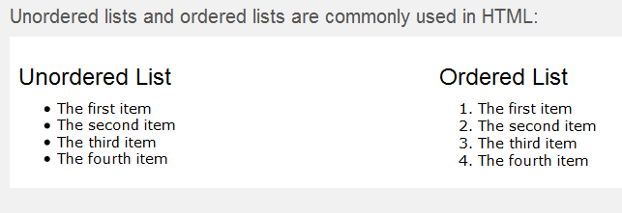
Ordered VS Unordered List

Slide 25
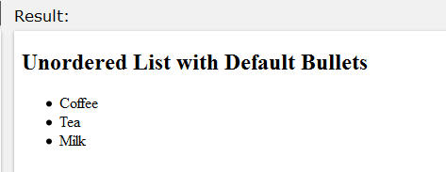
Unordered HTML Lists
An unordered list starts with the <ul> tag. Each list item starts with the <li> tag.
The list items will be marked with bullets (small black circles).
Example:
<!DOCTYPE html>
<html>
<body>
<h2>Unordered List with Default Bullets</h2>
<ul>
<li>Coffee</li>
<li>Tea</li>
<li>Milk</li>
</ul>
</body>

Slide 26
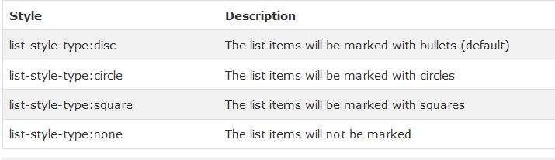
Unordered HTML Lists - The Style Attribute
A style attribute can be added to an unordered list, to define the style of the marker:

Slide 27
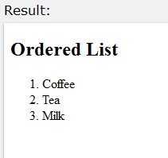
Ordered HTML Lists
An ordered list starts with the <ol> tag. Each list item starts with the <li> tag.
The list items will be marked with numbers:
Example:
<!DOCTYPE html>
<html>
<body>
<h2>Ordered List</h2>
<ol>
<li>Coffee</li>
<li>Tea</li>
<li>Milk</li>
</ol>
</body>
</html>

Slide 28
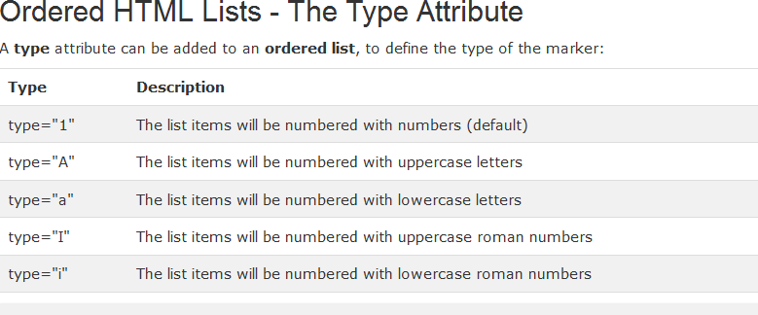
Continue

Slide 29
HTML Description Lists
HTML also supports description lists.
A description list is a list of terms, with a description of each term.
The <dl> tag defines the description list, the
<dt> tag defines the term (name), and the
<dd> tag describes each term:

Slide 30

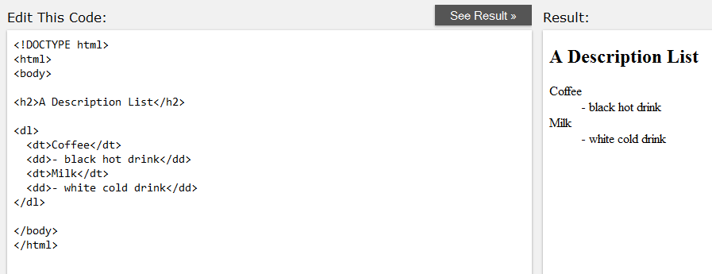
Example

Slide 31

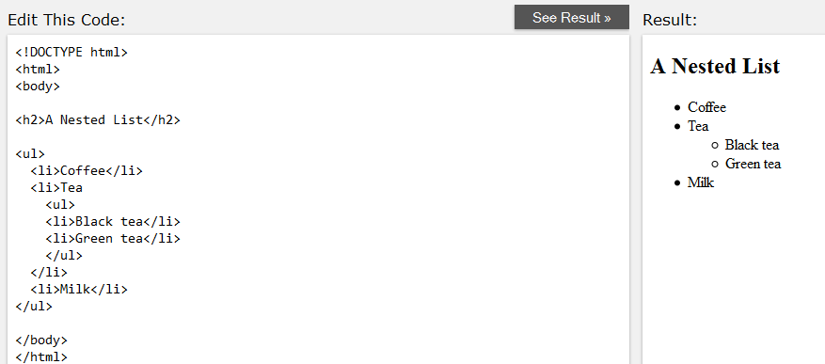
Nested HTML Lists
List can be nested (lists inside lists):

Slide 32
Horizontal Lists
HTML lists can be styled in many different ways with CSS.
One popular way, is to style a list to be displayed horizontally:

Slide 33

Example
<!DOCTYPE html>
<html>
<head>
<style> ul#menu {
padding: 0;
}
ul#menu li { display: inline;
}
ul#menu li a {
background-color: black; color: white;
padding: 10px 20px; text-decoration: none;
border-radius: 4px 4px 0 0;
}
ul#menu li a:hover { background-color: orange;
}
</style>
</head>
<body>
<h2>Horizontal List</h2>
<ul id="menu">
<li><a href="/html/default.asp">HTML</a></li>
<li><a href="/css/default.asp">CSS</a></li>
<li><a href="/js/default.asp">JavaScript</a></li>
<li><a href="/php/default.asp">PHP</a></li>
</ul>
</body></html>

Slide 34

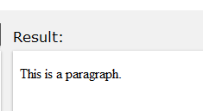
Comment Tags
Example:
<!-- This is a comment --> <p>This is a paragraph.</p> <!-- Remember to add more information here -->
Output:

